Slide 1
Passing the Objective Assessment
How to Prepare for the LPI Linux Essentials Certification Exam
C851 Cohort Session for Sunday, July 18, 2021
Dr. John S. Galliano | C851 Course Instructor

Slide 2
Agenda
Welcome
5 Domains
Exam Specifics
Demos/Hands-on
Sample Exam Questions
Wrap-Up

Slide 3

5 Exam Domains
The Linux Community and a Career in Open Source
Finding Your Way on a Linux System
The Power of the Command Line
The Linux Operating System
Security and File Permissions
Notes:
• Understanding the Linux industry and the open source movements
• Understanding the major components of a Linux distribution
• Gaining the technical proficiency to work on the Linux command line
• Gaining a basic understanding of security and administration in Linux
• Gaining a basic understanding of how to work with users, groups, and permissions

Slide 4

About the Exam
Closed book
Up to 60 minutes
40 multiple-choice with some multi-select and fill-in-the-blank items
Minimum score of 500 points to pass, on a scale of 200 to 800
No prerequisites
Lifetime certification

Slide 5
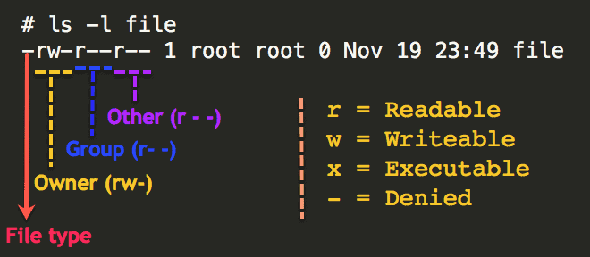
Files and Permissions

Slide 6
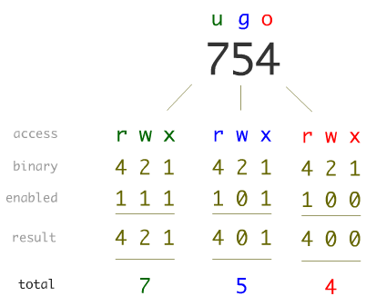
UGO?

Slide 7

Let’s Do Some Demos!
If you want to follow along, fire up your VM
Notes:
• Understanding the Linux industry and the open source movements
• Understanding the major components of a Linux distribution
• Gaining the technical proficiency to work on the Linux command line
• Gaining a basic understanding of security and administration in Linux
• Gaining a basic understanding of how to work with users, groups, and permissions

Slide 8
Sample Questions

Slide 9
Answer:
Which of the following can you NOT install Linux on?
Cloud servers
Desktops
Smartphones
Smartcard
D. Smartcard

Slide 10
Answer:
Which of the following is the on-demand availability of computer system resources, especially data storage and computing power, without direct active management by the user?
Remote Computing
On-demand Computing
Cloud Computing
Passive Computing

Slide 11
Answer:
Which keyboard shortcut allows copying highlighted text while working in the command line terminal?
CTRL + C
CTRL + SHIFT + C
CTRL + ALT + C
CTRL + TAB + C

Slide 12
Answer:
Which of the following can be used to represent a single number from 3 to 9?
[3456789]
[3-9]
[three-nine]
[9-3]

Slide 13
What Questions Do you Have for Me?

Slide 14
































Icon Library - Page 1

Slide 15




























































Icon Library - Page 2

